Slide 1
Catch basin
gutter
Flow on street
Leader pipe
road
Flow in pipe
manhole
Storm pipe

Slide 2
1. Rim of node is the top of the street cross section
2. Inlet
Model all the street catch basins connected to this node as a single inlet.
gutter
road
manhole
Storm pipe

Slide 3
road
manhole
Storm pipe

Slide 4
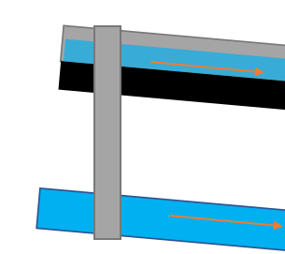
1. Splitting the node at the street invert into top and bottom nodes
3. Connecting the street to the top node
2. Adding rating curve to model inlet capacity
3. Connect the underground pipe to the bottom node

